Slide 1
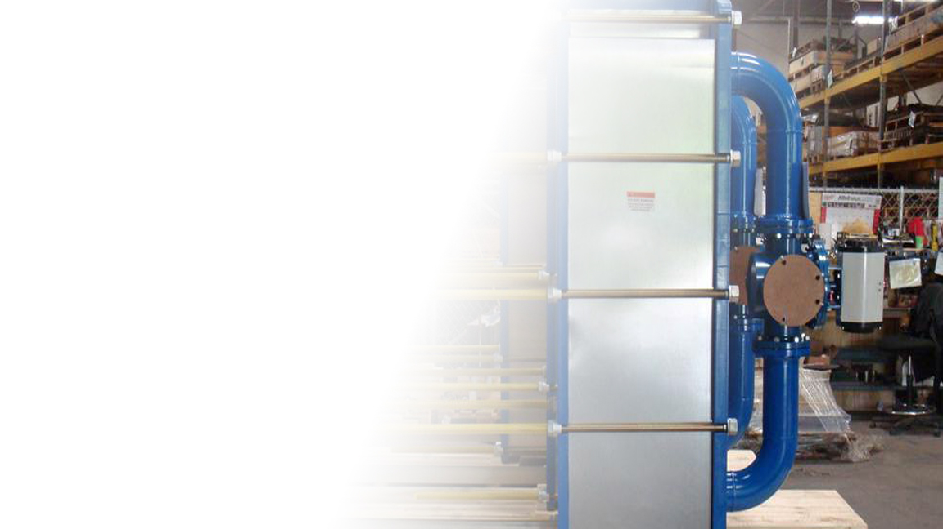
GASKETED PLATE HEAT EXCHANGER

Slide 2
ME 310
THERMO-FLUID SYSTEM DESIGN
Presented by,
GROUP 3
Sabit Hasnat Mahee (1910091)
Md. Shahriar Parvez (1910114)
Barkat Ullah Fahad (1910115)
Arman Mia (1910117)

Slide 3
contents
5
6
7
1
2
3
4
Results and design optimizations
Manufacturing process
Conclusion
Abstract
Objective
Problem statements
Design strategy

Slide 4
Abstract
Heat exchangers play a pivotal role in various industries by facilitating efficient heat transfer between two fluid streams while maintaining their thermal isolation. The primary objective of heat exchangers is to optimize the utilization of thermal energy, minimizing energy wastage and reducing operational costs. They find extensive use in sectors such as HVAC systems, power generation, chemical processing, and refrigeration.

Slide 5
Gasketed Plate Heat Exchanger
The gasketed plate heat exchanger (GPHE) is a versatile and highly efficient heat transfer device widely used in industrial applications. GPHEs are compact and modular heat exchangers consisting of corrugated plates with gaskets in between. These gaskets ensure a leak-free operation while allowing for easy maintenance and plate replacement
gasketed plate heat exchangers offer an efficient and space-saving solution for heat transfer needs across diverse industries

Slide 6
Our objectives….
Improve the efficiency of heat transfer within the plate heat exchanger to maximize the exchange of thermal energy
Reduce energy consumption by optimizing the design and operation
cost savings and environmental benefits
to minimize downtime and maintenance requirements

Slide 7
Problem statement:
In a food processing plant 0.6 kg/s water at 50˚ C is to be cooled using 0.6 kg/s water available at 20˚ C. Targeted fluid should be reduced to 45˚ C at least. Dimension of heat exchanger plate should be: L:14 in, W:8 in
Thickness of plate: 0.8mm. Our target is to determined final temperature of hot water and number of plate needed for the heat exchanger. We assume fouling factor: 0.00009 m²K/W

Slide 8
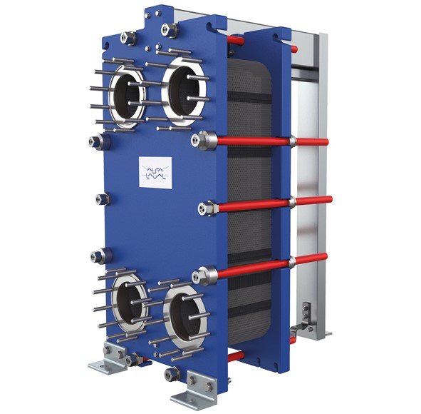
Design strategy
CAD modelling
Design and performance calculation
Parametric studies

Slide 9

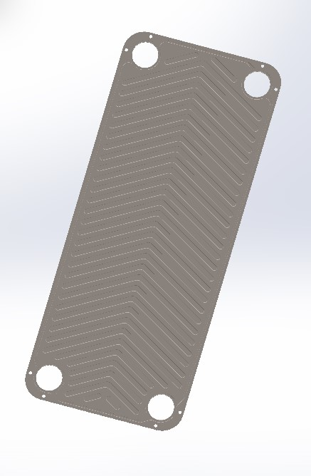
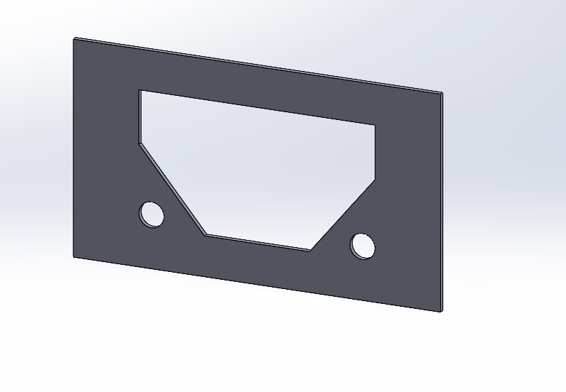
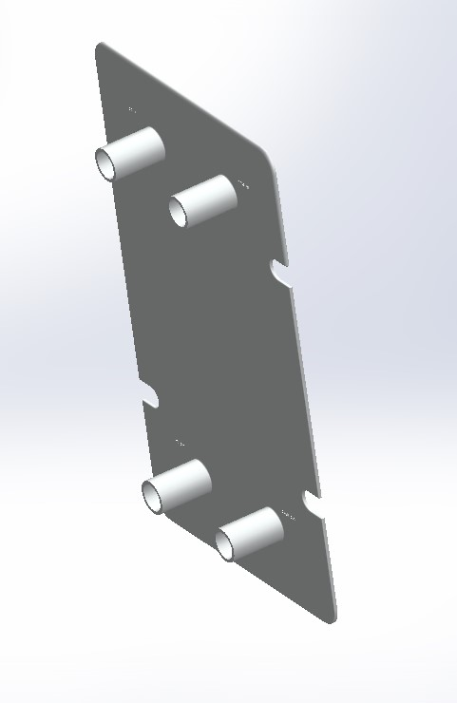
Design strategy
CAD modelling

Slide 10
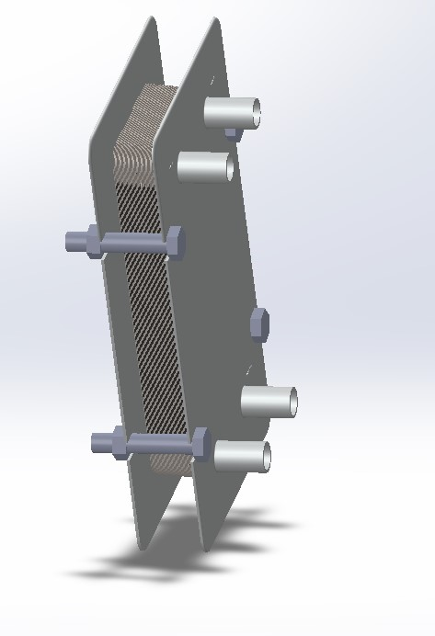
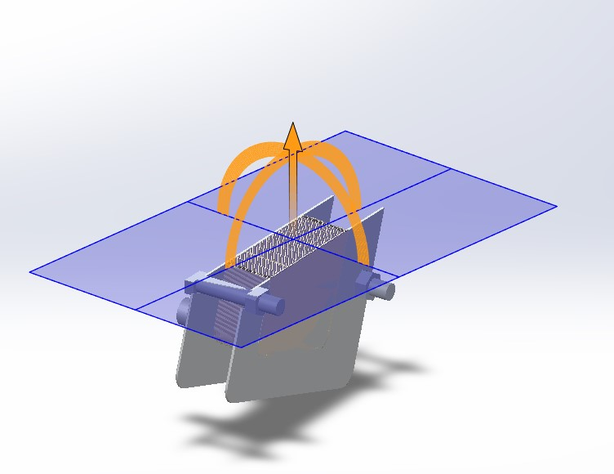
Section view
Full assembly

Slide 11
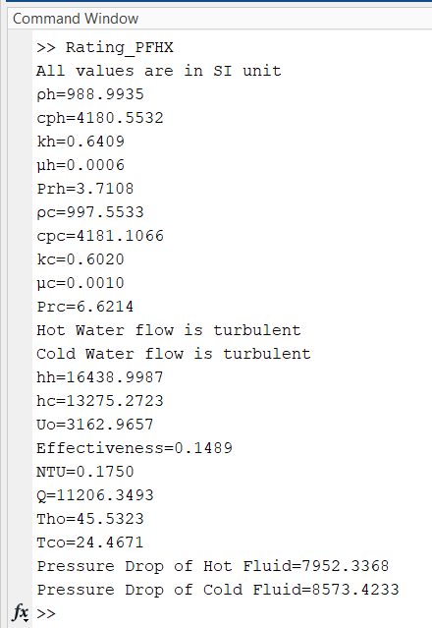
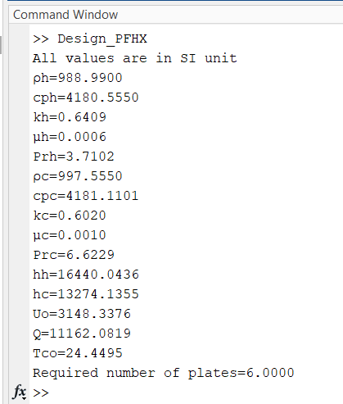
Thermal and hydraulic calculation by MATLAB
Design calculation
Rating calculation

Slide 12
Final results
Effective plate number: 6
Heat transfer rate, Q: 11206.3493 W
Outlet temperature of hot fluid (T_{ho}): 45.5323 ˚ C
Outlet temperature of cold fluid (T_{co}): 24.4671 ˚ C
Pressure Drop of Hot Fluid: 7952.3368 Pa
Pressure Drop of Cold Fluid: 8573.4233 Pa

Slide 13
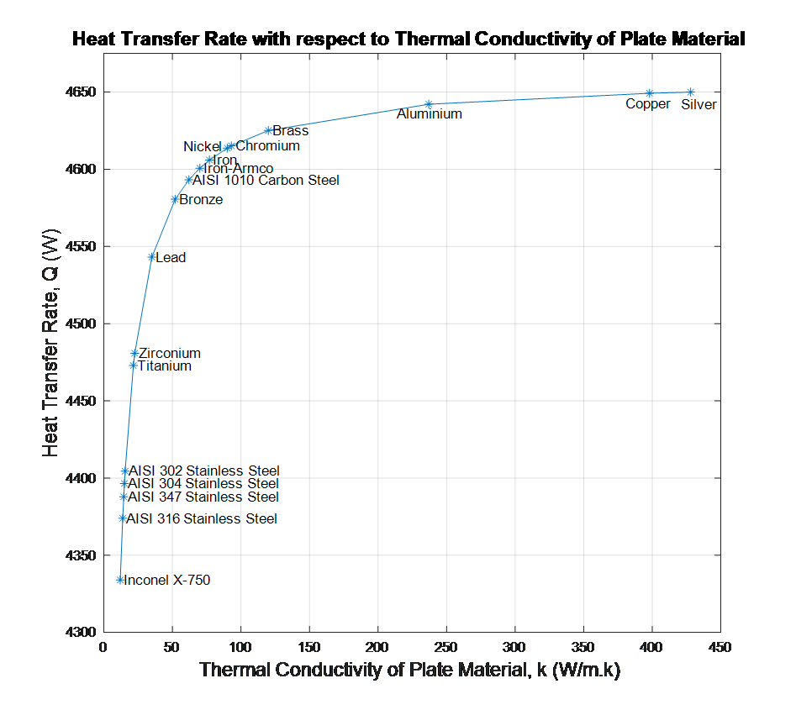
Parametric studies

Slide 14
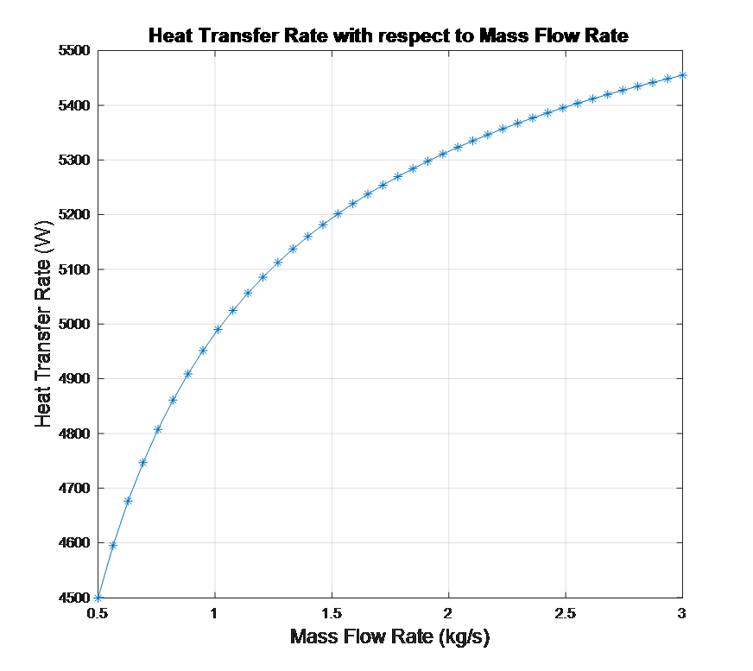
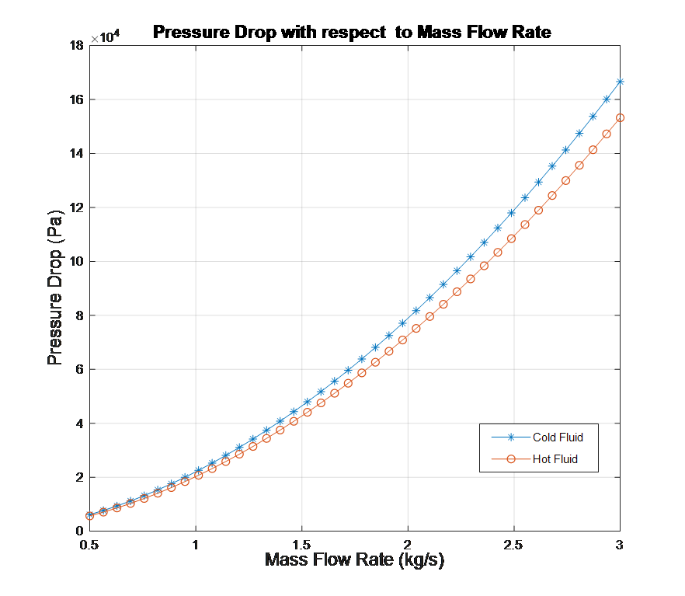

Slide 15
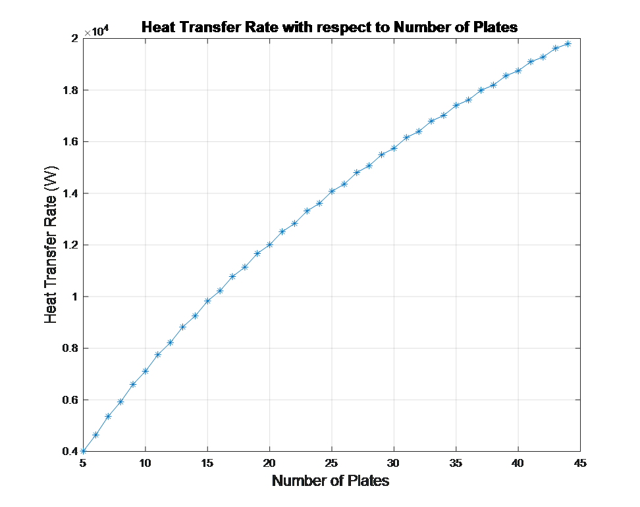
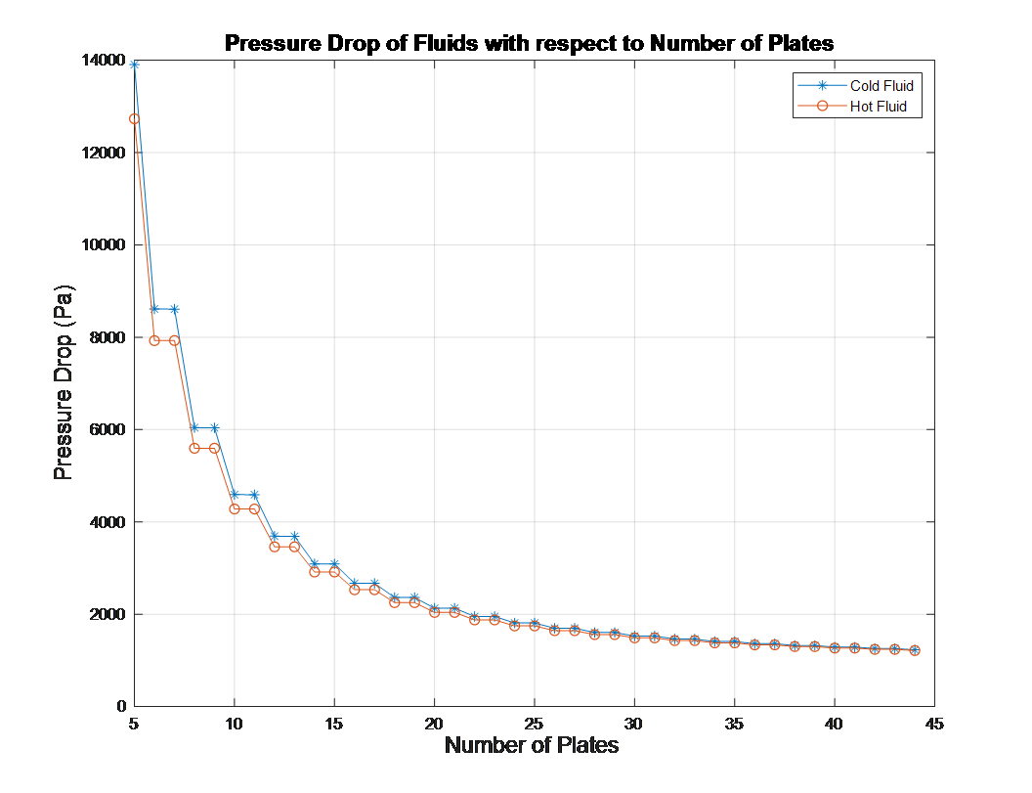

Slide 16
Manufacturing process
Material selection:
Material for plate: we used corrugated Aluminums for plate as it has good conductivity also cheaper than copper. Also market availability is a reason.
Cover plate material: We used Mild steel as cover plate material as they are strong. Thus give good compatibility to our gasket and plate
Gasket material: we used rubber for gasket

Slide 17
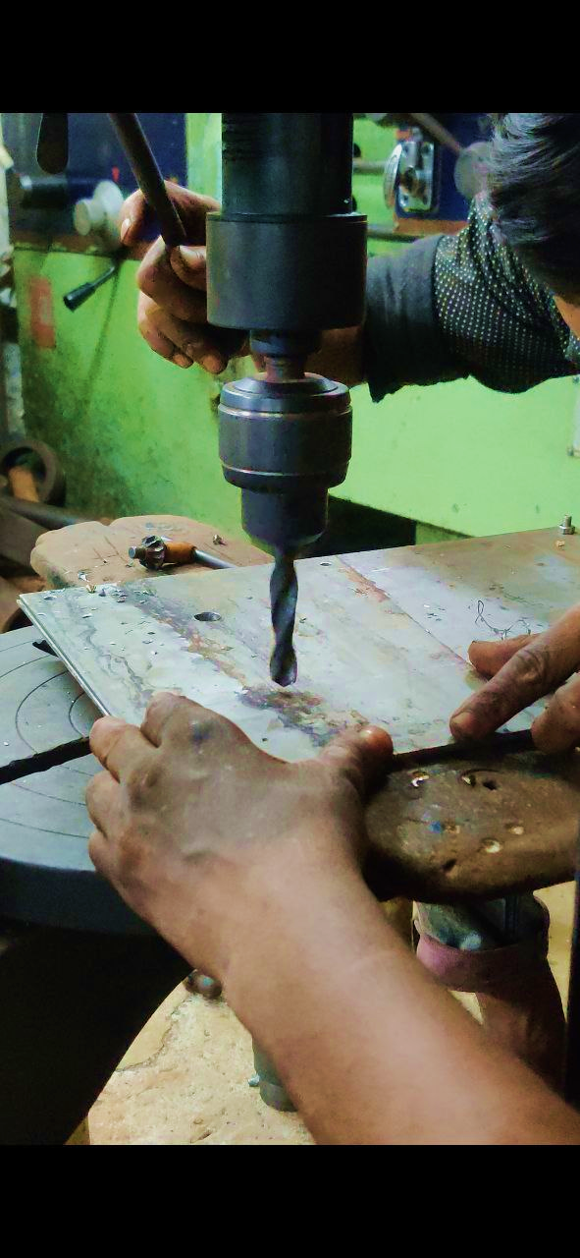
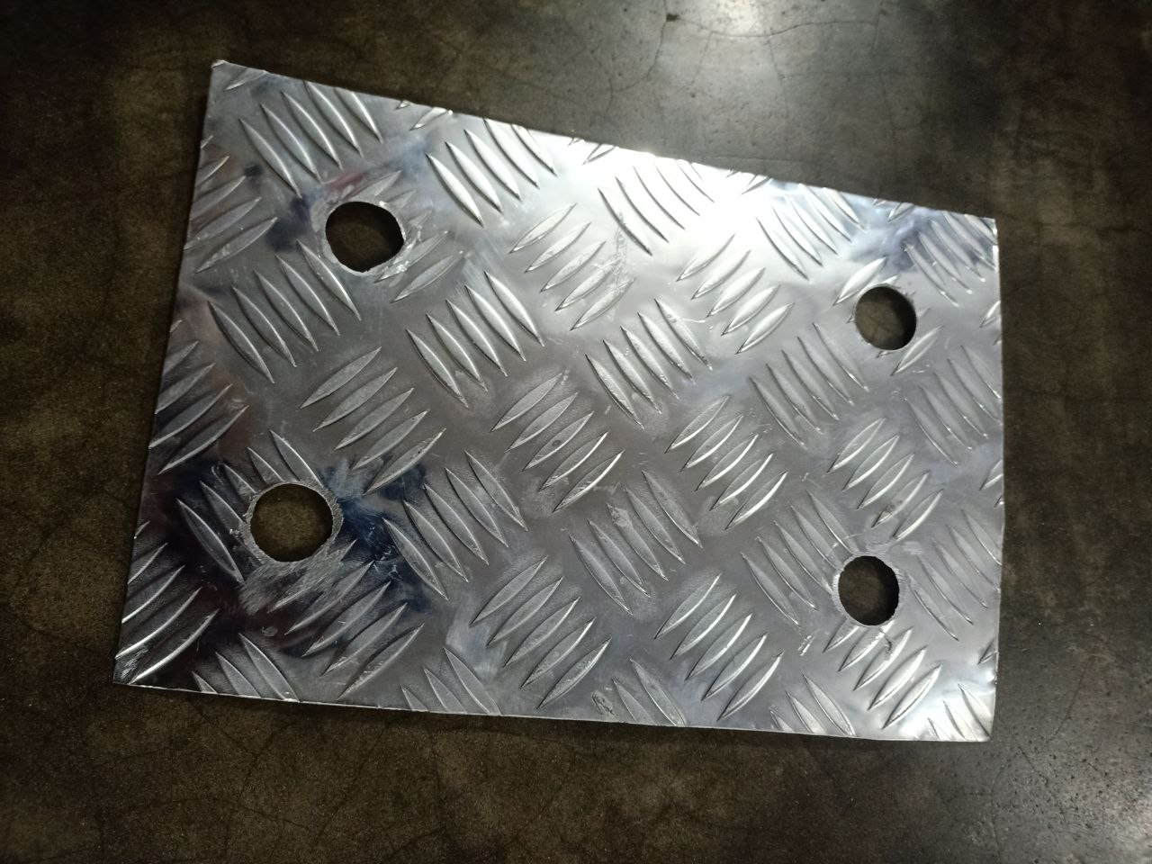
Manufacturing process
1. Cutting plate
We cut the plate according to our calculated dimension
2. Making of holes in the plate
Our hole diameter is 1 inch.
Grinding was needed for hole finishing

Slide 18
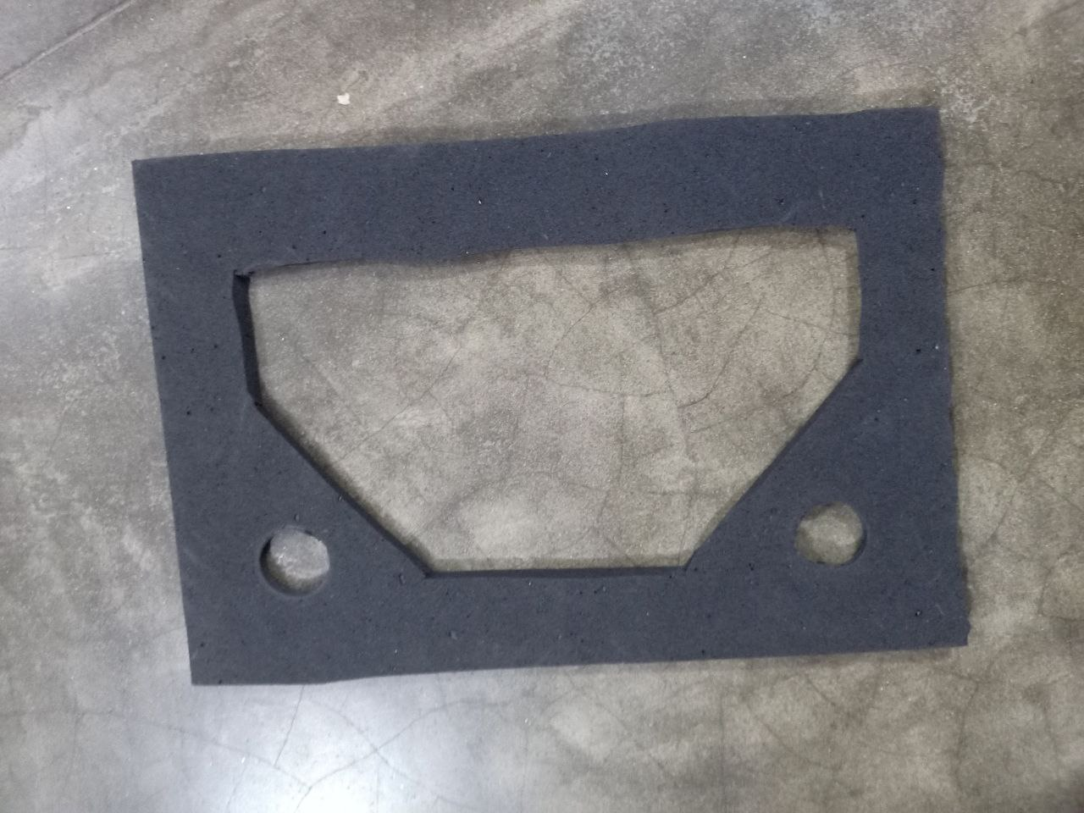
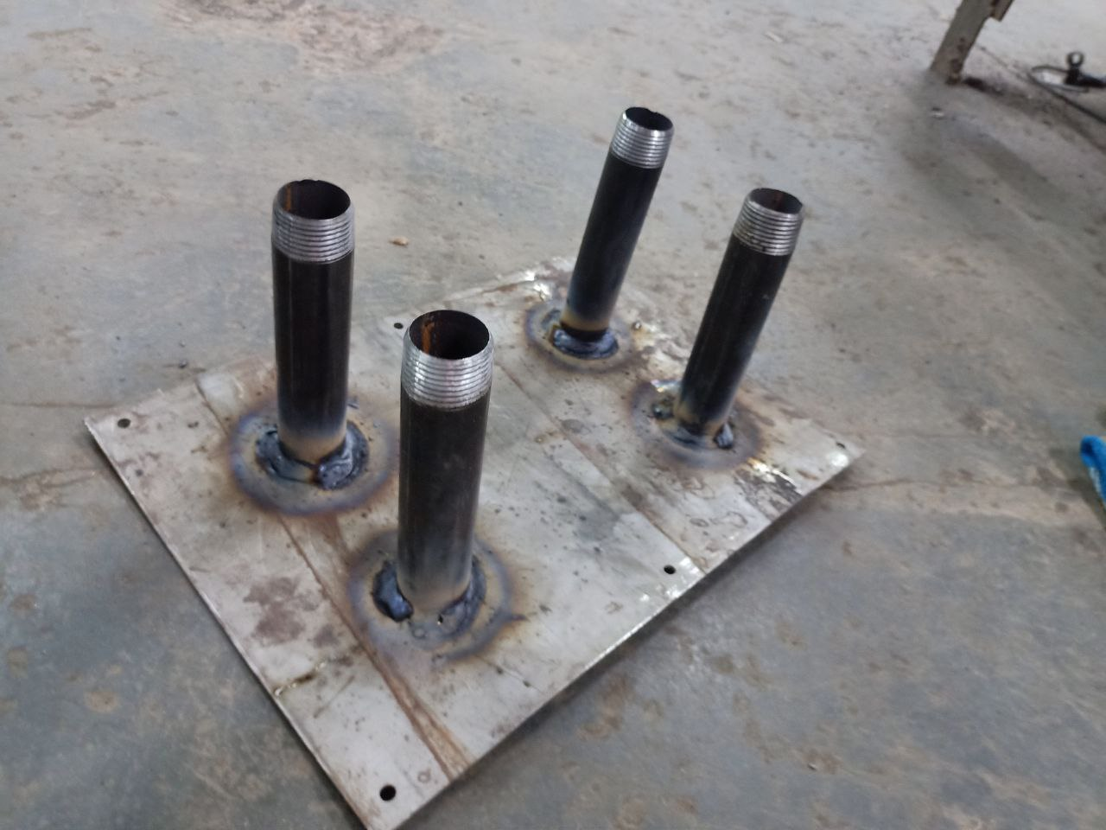
Manufacturing process
3. Gasket making
We made the gasket manually with cutters
To get our desired shape
4. Making cover plate
We drilled according to our plate and GI pipe were welded to the cover plate for inlet and outlet

Slide 19
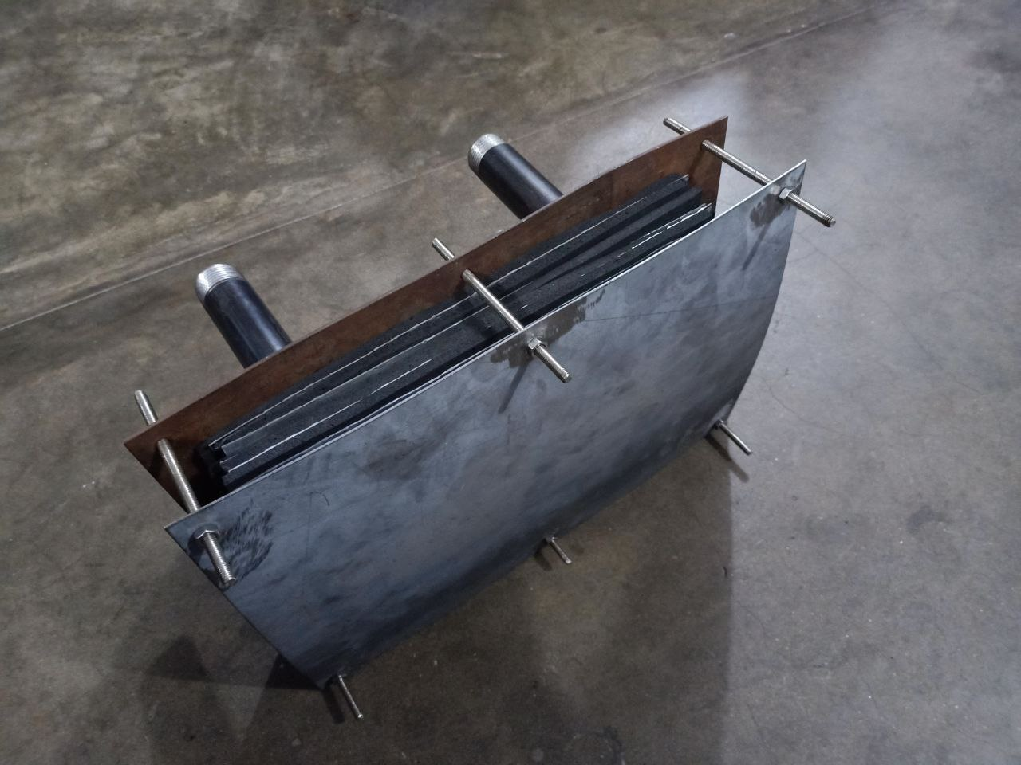
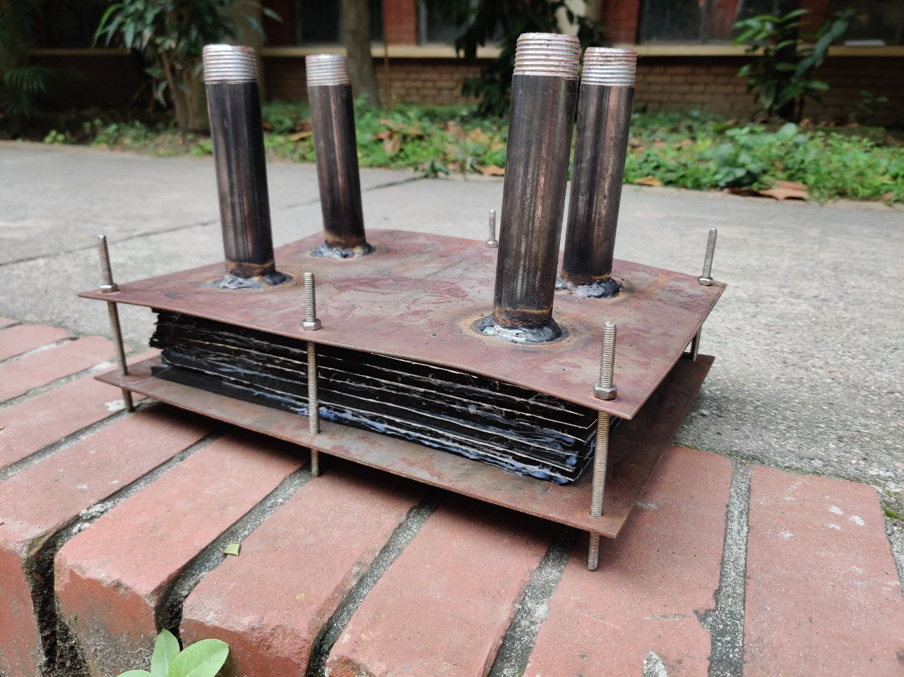
Manufacturing process
5.Final assembly
We used double sided bolt and nut joint to stack gasket and plates together

Slide 20
Performance testing
Our heat exchanger withstands the highest flowrate(1 m³/hr) provided by fluid lab without any internal or external leakage.
Our heat exchanger withstands a pressure of 10 psi. After then water leakage happens.

Slide 21
Overall cost
Description | Unit cost | Total cost (BDT)
Mild steel sheet | 110(per kg) | 360
Al sheet | 170 (per ft) | 1000
Metal sheet cutting | - | 250
Rubber sheet | 25(per ft) | 150
Joint pipe | 100 (per pcs) | 400
Drilling and Grinding | - | 700
Fasteners | 40 (per pcs) | 240
Glue gun | - | 250
Transport | - | 660
Total | - | 4010

Slide 22
limitations
We didn’t find plate with both side corrugation. Hence effective heat transfer was reduced
Normally gasketed plate has profile for gasket to set in. Due to lack of resources we didn’t make profile on the plate for gasket. This is the main reason for leakage
Our HX is very small compare to those used in the industry.
We used glue to reduce leakage. Which is very impractical for industry

Slide 23
Further Improvement
CNC machine can be used to make desired corrugation on both surface of plate. Also profile can be made on the plate for gasket
Stainless steel can be used for plate material for better conductivity
Bigger fasteners and thicker cover plate can be used to make the assembly more compact and leakage can be further reduced
selecting the most appropriate plate corrugation pattern for your specific application. Different patterns can offer varying levels of turbulence and heat transfer efficiency
Insulating the HX by insulated cover case can minimize heat losses to the surroundings

Slide 24
Acknowledgement
Priom Das
(Lecturer, Department of Mechanical Engineering,BUET)
Md. Aminul Islam
(Lecturer, Department of Mechanical Engineering,BUET)
Tanvir Anam Tipu
(Teaching Assistant, Department of Mechanical Engineering, BUET)

Slide 25
Thank you

